Slide 1

2013 Summer Co-Op Review
May 23, 2012
Braden Licastro
May – August & November 2013

Slide 2
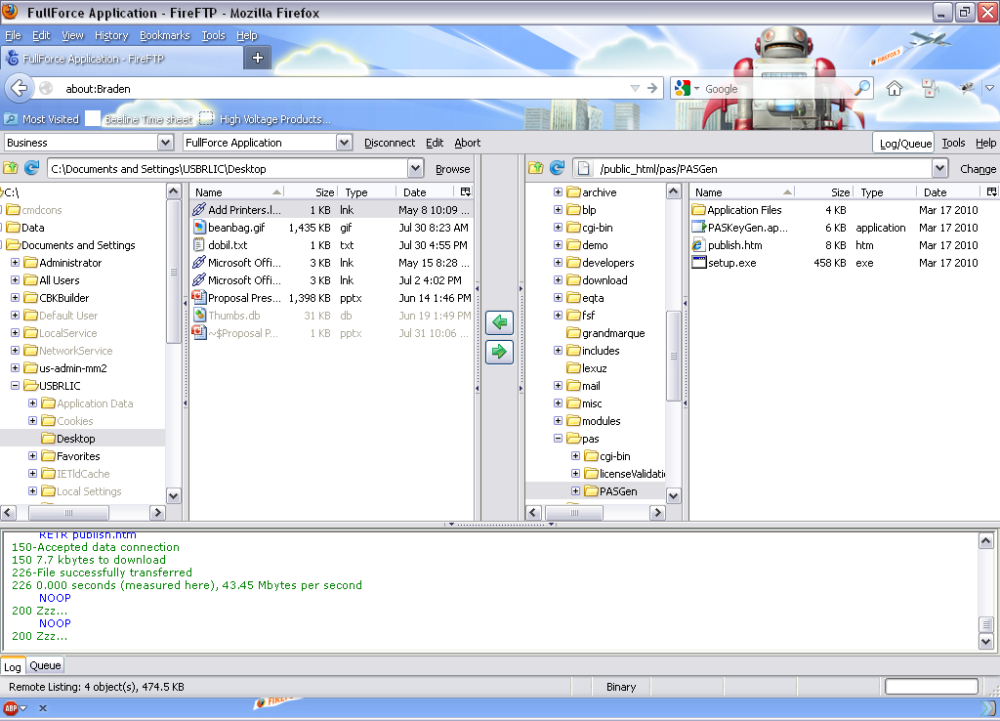

Profile: Braden Licastro
School Attending: Allegheny College
Class Standing: Senior
Major: Computer Science
Minor: Economics
Manager: Jim Zakrzwski

Slide 3
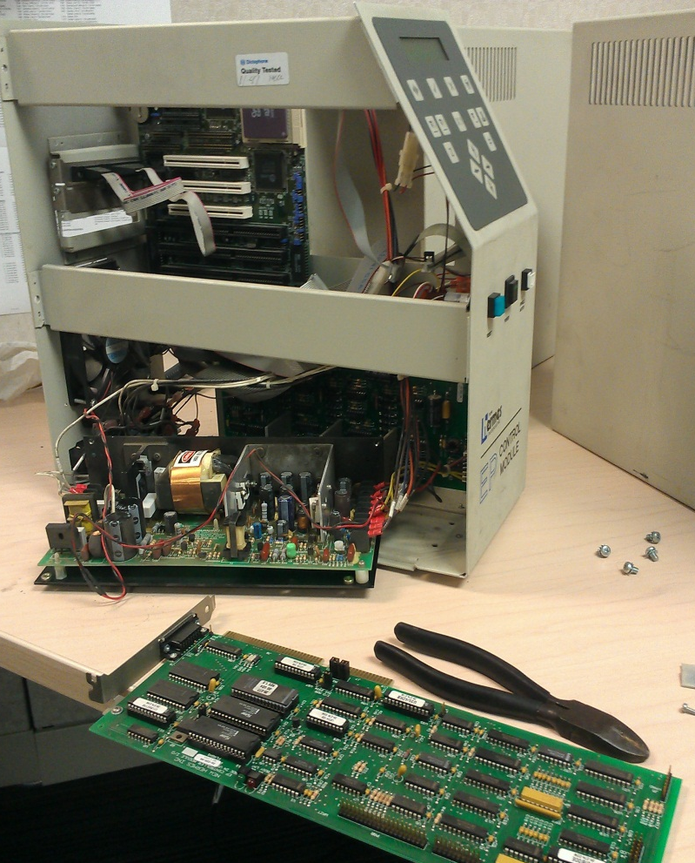
Project: Vibratory Engraver Repair
Scope: Upgrade PC, restore engraver and Control Unit to working condition.
Goals: Upgrade computer to GravoStyle 7
Diagnose, repair, and clean engraver / control unit.
Configure, calibrate, and test engraver software to ensure proper function.

Slide 4
Project: Vibratory Engraver Repair
Challenges Overcome
No prior experience using engraving machines, configuration lost when computer failed
Both computer and engraver control unit failed
Upgrading specialized software from MS-DOS to Windows 7
No documentation available to assist with repairs

Slide 5
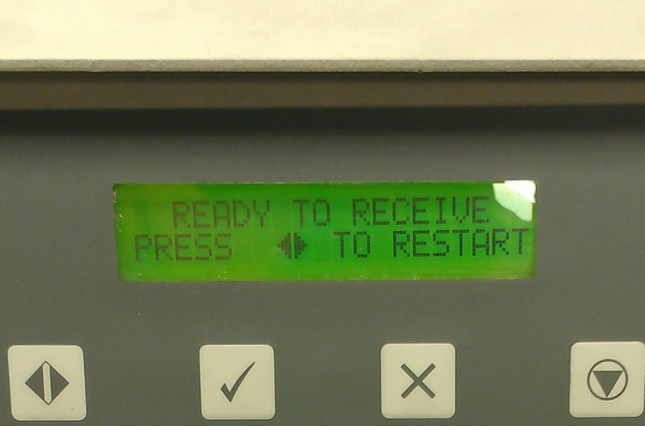
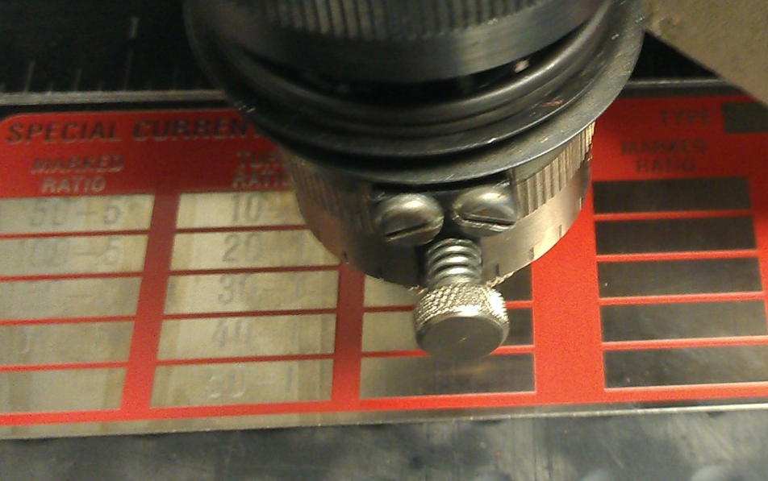

Project: Vibratory Engraver Repair
Project outcome:
Upgraded, repaired, and calibrated engraver and computer system. Test engrave successfully completed.
Problem resolved and customer satisfied!

Slide 6
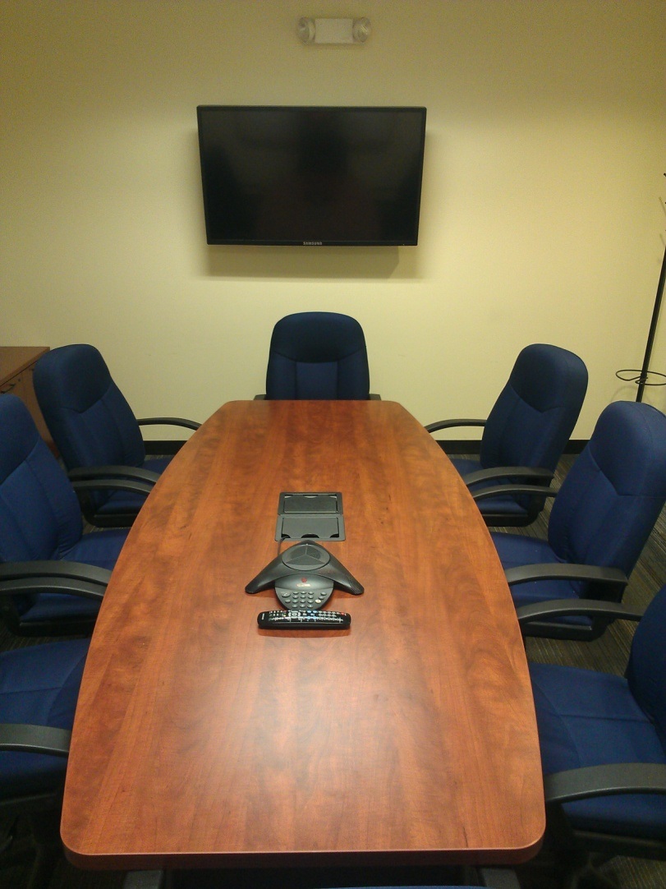
Project: Conference Room Maintenance
Goal:
Ensure conference rooms renovated last summer were still in working order and repair any damage.
Rework product support and production conference rooms.
Problem resolved and customer satisfied!

Slide 7
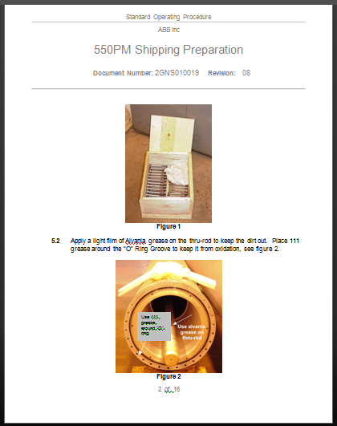
Project: Change Requests
Scope: Update technical documents to reflect new process changes.
Project Outcome: All requests completed and submitted for approval.
Problem resolved and customer satisfied!

Slide 8
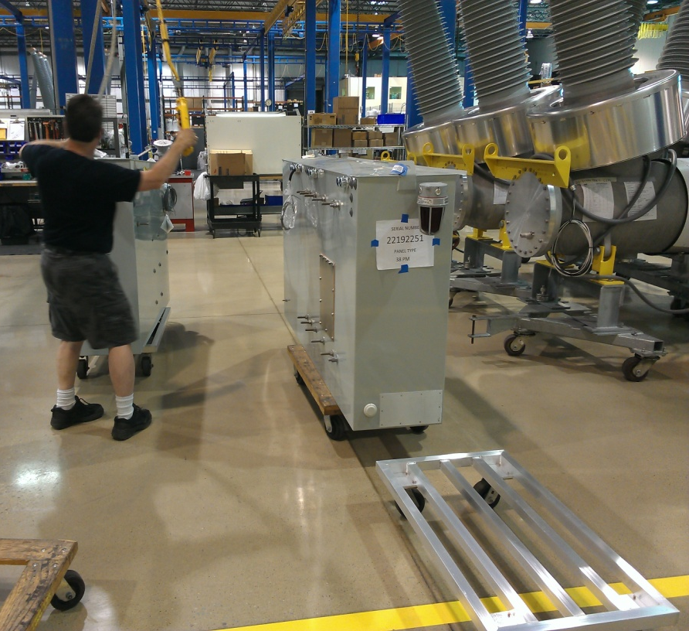
Project: Production Floor Wood Reduction
Scope: Coordinate the change away from wood tooling from the production floor.
Project Outcome: All wood tooling successfully replaced with aluminum. No impact on manufacturing.
Problem resolved and customer satisfied!

Slide 9
Project: Server Room Renovation
Goals:
Remove hydraulic fire suppression and install modern Halon replacement.
Install hard ceiling and create airtight space.
Upgrade HVAC and lighting to accommodate fire system
Install whole-room, 2.5 hour battery backup with surge protection and monitoring.
Upgrade legacy and damaged equipment.
Upgrade wiring in server room and remote computing cabinets.

Slide 10
Project: Server Room Renovation
Challenges Overcome
No on-site IT support for diagnostics and assistance
Project could not interrupt day-to-day operations
Working with obsolete, heavy, and delicate equipment
Coordinating construction schedule with several contractors
Researching, purchasing, and installing unfamiliar equipment and technologies

Slide 11
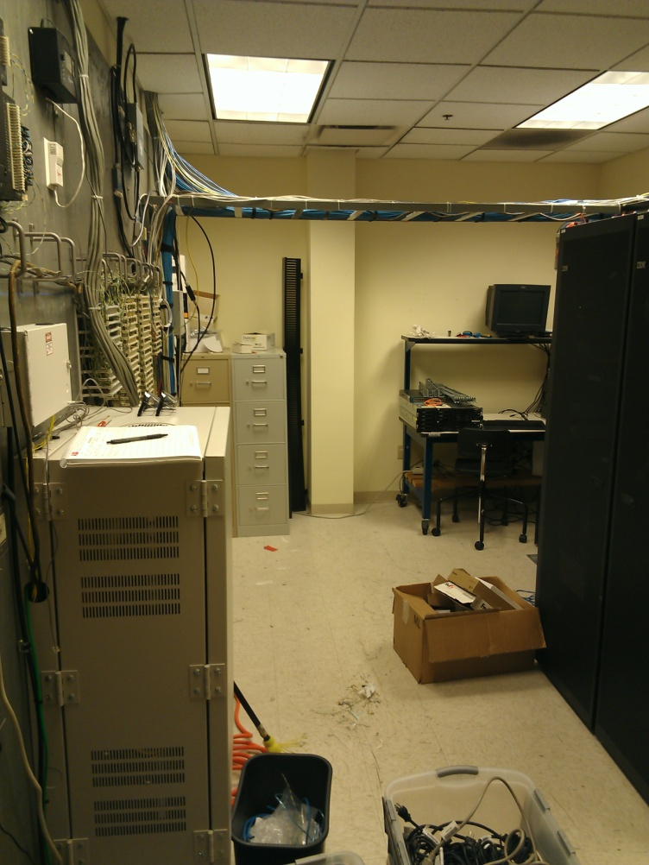
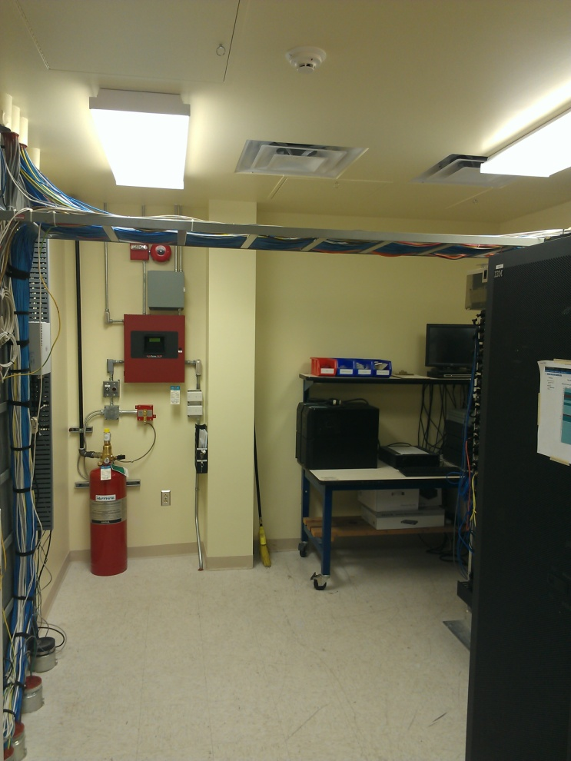
Project: Server Room Renovation
Project Outcome:
Room construction completed and passed inspections

Slide 12
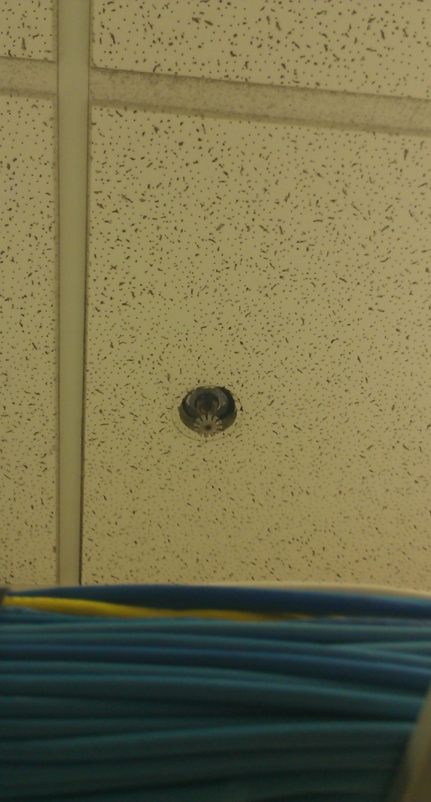
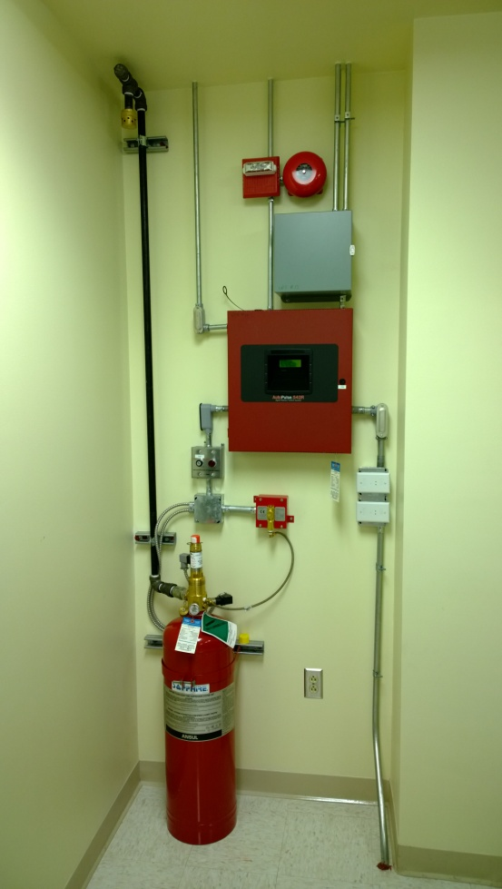
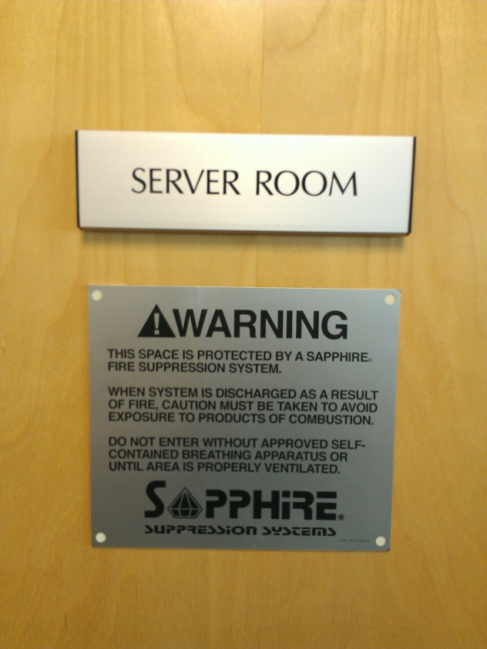
Project: Server Room Renovation
Project Outcome:
Sapphire Fire Suppression installed and operational

Slide 13
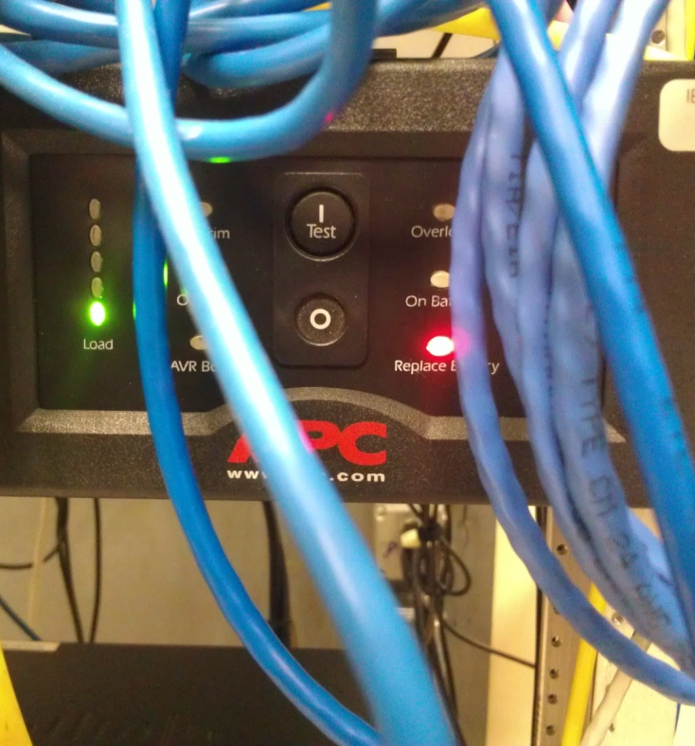
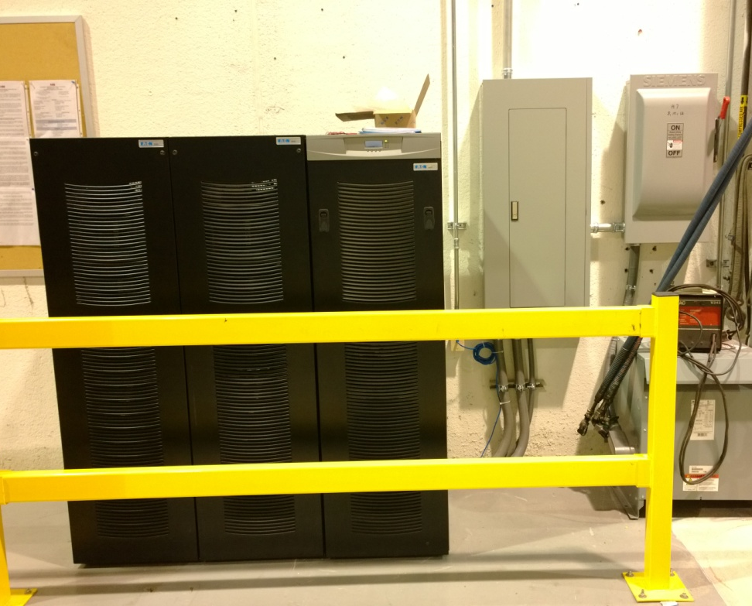
Project: Server Room Renovation
Project Outcome:
2.5 Hour Battery Backup Installed and Operational

Slide 14
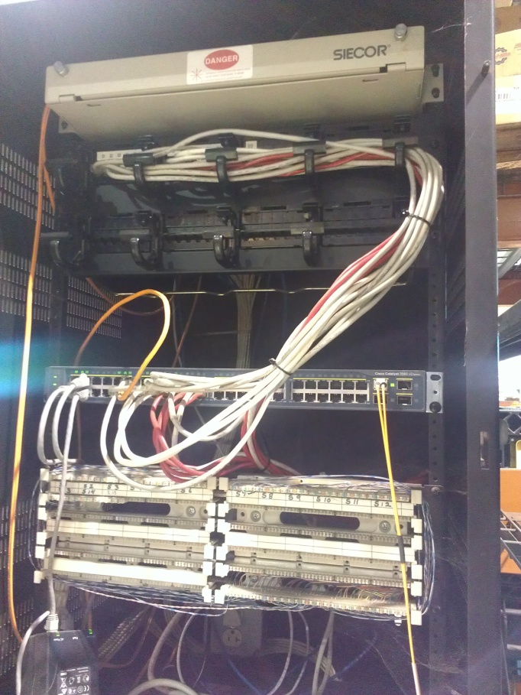
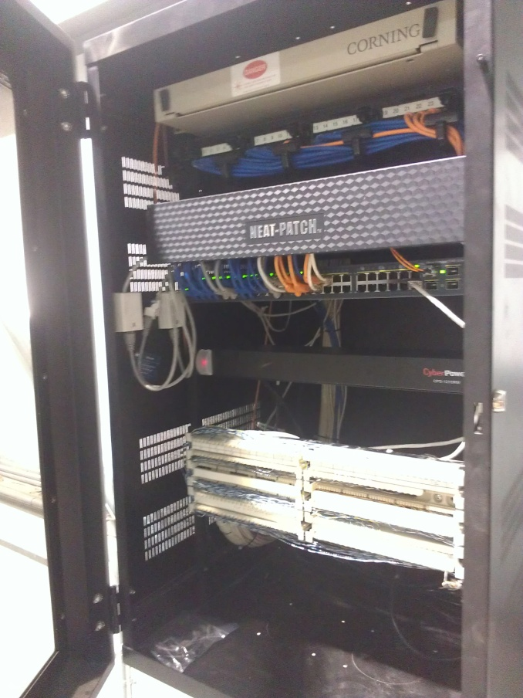
Project: Server Room Renovation
Project Outcome:
Remote network cabinets rewired and upgraded

Slide 15
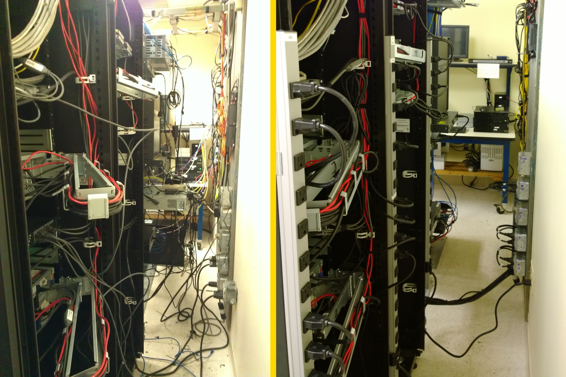
Project: Server Room Renovation
Project Outcome:
Server Racks and miscellaneous equipment upgraded, rewired, and operating on redundant power.

Slide 16
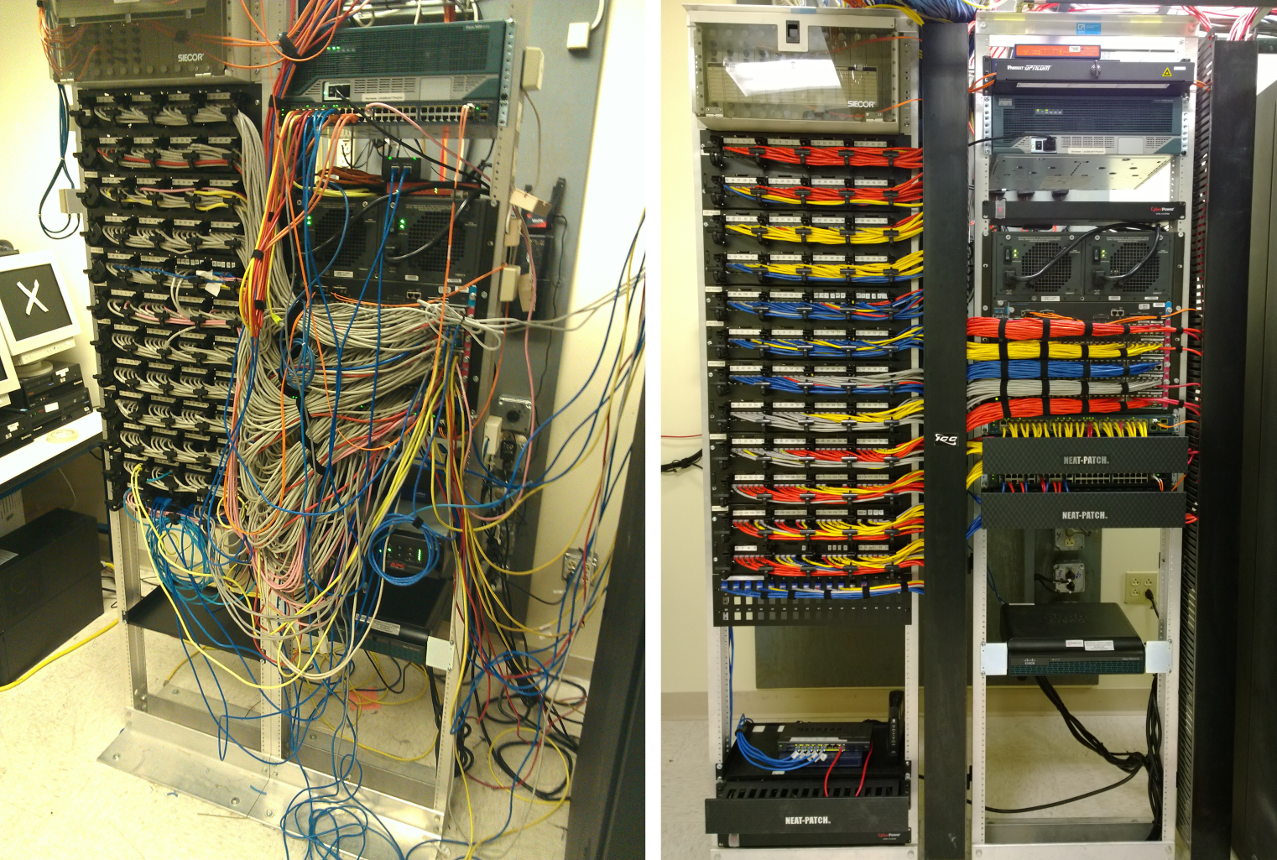
Project: Server Room Renovation
Project Outcome:
Data Racks upgraded, rewired, and operating on redundant power.
New standards created --racks organized, and wired appropriately.

Slide 17
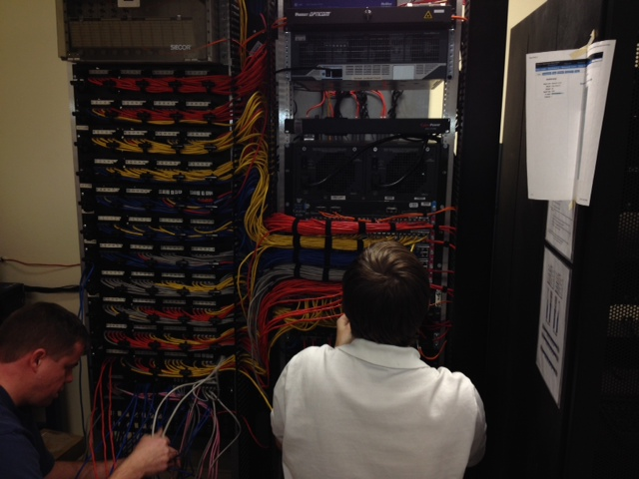
Project: Server Room Renovation
Conclusion:
Network upgrades functioning perfectly.
No production downtime occurred.
Modern, reliable, and maintainable setup will reduce future maintenance costs.
Problem resolved and customer satisfied!

Slide 18
Beneficial Experiences
Learning how corporations manage funds and logistics for purchases
Successfully coordinating schedules with large groups of people and contractors
Working cooperatively in a union environment
Communicating with out of state and country resources to complete a task
Using past experiences and knowledge to complete a difficult or new task

Slide 19


